Slide 1
Appendix B: Greenplum and Hadoop Integration
This appendix describes how to integrate Hadoop with a pre-existing Greenplum environment.
Upon completion of this module, you should be able to:
  Use Hadoop Distributed File System tables in a Greenplum database.
  Grant privileges on the HDFS protocol
  Create a Greenplum external table and populate it with HDFS data
Notes:
Appendix B: Greenplum and Hadoop Integration
Data co-processing of structured and unstructured data with Greenplum Database and Hadoop respectively is possible by integrating the two databases and taking advantage of the parallel processing architecture inherent in Greenplum Database.
Greenplum Database supports integration of a Hadoop Distributed File System by providing access to the gphdfs protocol to read and write unstructured data.
In this module, you will:
Integrate Greenplum Database to the Hadoop Distributed File System.
Create an external table from Greenplum Database to files on a pre-existing Hadoop file system.

Slide 2
Summary of Steps for Hadoop Integration
To integrate a pre-configured Hadoop environment with a pre-existing Greenplum Database, the following must be performed:
Set environmental variables required for integration process
Set Greenplum configuration parameters for working with Hadoop
Grant privileges to HDFS protocol
Once configured, you can create a Greenplum external table to content in Hadoop
Notes:
To integrate Greenplum to Hadoop Distributed File System you must:
Configure several environmental variables
Modify several Greenplum configuration parameters required for Hadoop integration
Perform a one-setup and grant privileges for the HDFS protocol.
Identify and execute on-time setup
Grant privileges for the HDFS protocol
Once the integration between the two databases has been configured, you can create a Greenplum external table to content that resides on the Hadoop Distribute File System.

Slide 3



Greenplum and Hadoop Integration
Analytic Productivity
Applications, Tools, Chorus
Data Computing Interfaces
SQL, MapReduce, In-Database Analytics, Parallel Data Loading (batch or real-time)
Greenplum Database
Hadoop
Compute
Compute
parallel
data exchange
Storage
Storage
SQL DB
Engine
Greenplum
parallel
data exchange
MapReduce
Engine
Hadoop
Network
unstructured data
structured data
temporal data
All Data Types
geospatial data
sensor data
spatial data
Notes:
Greenplum and Hadoop Integration
Greenplum Database and Hadoop are complementary technologies that deliver a powerful solution for the analytics of structured, semi-structured, and unstructured data.
Some benefits of integrating the two technologies are listed below.
Perform complex, high-speed, interactive analytics using Greenplum Database.
Analytic Productivity, applications, Tools, and Chorus can be used on HDFS (Hadoop Distributed File System) data
Data computing interfaces such as SQL and MapReduce
Stream the data directly from Hadoop into Greenplum Database to incorporate unstructured or semi-structured data in the above analyses within Greenplum Database
Hadoop can also be used to transform unstructured and semi-structured data into a structured format that can then be fed into Greenplum Database for high speed, interactive querying

Slide 4



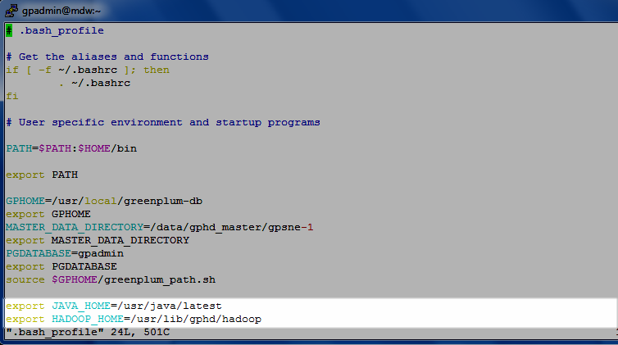
Set Environmental Variables
Example of .bash_profile for the user gpadmin
export JAVA_HOME=/usr/java/latest
export HADOOP_HOME=/usr/lib/gphd/hadoop
Install the Hadoop client in the Greenplum cluster
Notes:
Set Environmental Variables
You will need to set several environmental variables for the gpadmin user in your Greenplum environment.
From the Greenplum master server, add the following lines to the .bash_profile of the gpadmin user.:
export JAVA_HOME=/usr/java/latest
export HADOOP_HOME=/usr/lib/gphd/hadoop
The JAVA_HOME variable should be set to the location of java on the master server. The integration requires Java 1.6, which you will need to download and install on all Greenplum database hosts, including the master, standby, and segment hosts.
The HADOOP_HOME variable must point to the location of the Hadoop libraries, which are available from the Hadoop client. You will need to install the Hadoop client in the Greenplum cluster on all hosts before proceeding. This ensures access to all Hadoop libraries.

Slide 5
Server Configuration Parameters for Hadoop Targets
Parameter | Available Value | Hadoop Distribution | Default Value
gp_hadoop_target_version | gphd-1.0 | Greenplum HD 1.1/1.2 | gphd-1.1
 | gphd-1.1
 | gphd-1.2
 | gphd-2.0 | Pivotal HD 1.0/2.0
 | gpmr-1.0 | MapR 1.x, 2.x, 3.x
 | gpmr-1.2 | MapR 4.x
 | cdh3u2 | Cloudera 4.1-4.7
 | cdh4.1 | Cloudera 5.0/5.1
 | hdp2 | Hortonworks Data Platform 2.1
gp_hadoop_home | The value stored in the $HADOOP_HOME variable |  | NULL
Notes:
Server Configuration Parameters for Hadoop Targets
After setting the parameters, you will need to update the following master server configuration parameters in the postgresql.conf file with the gpconfig command:
gp_hadoop_target_version
gp_hadoop_home
If not specified in the postgresql.conf, Greenplum will use the gphd-1.1 library for the integration. If your distribution differs, select the appropriate value from the Available Value column.
The gp_hadoop_home parameter must be the same as the HADOOP_HOME variable set in the .bash_profile file. In this case, it is set to /usr/lib/gphd/hadoop.
After modifying the postgresql.conf file, you will need to re-read the postgresql.conf file with the gpstop -u command.

Slide 6
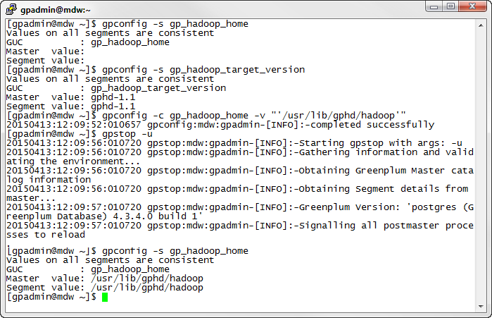
Setting the Parameter Values
Update the parameters to the appropriate values

Slide 7

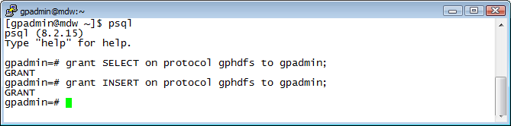


Grant Privileges for gphdfs Protocol
Usage: Granting read and write privileges to gpadmin
gpadmin=# GRANT SELECT ON PROTOCOL HDFS TO gpadmin;
gpadmin=# GRANT INSERT ON PROTOCOL HDFS TO gpadmin;
A fly and a flea in a flue
Were imprisoned, so what could they do
Said the fly, let us flee. Let us fly said the flee
So they flew through a flaw in the flue.
A canner exceedingly canny
One morning remarked to his granny
A canner can can anything that he can
But a canner can’t can a can can he?
Note: The SELECT privilege allows gpadmin to create readable external tables with the gphdfs protocol. The INSERT privilege lets you create and use writable external tables with the gphdfs protocol.
Notes:
Grant Privileges for gphdfs Protocol
You must now provide read and write privileges on the gphdfs protocol to the gpadmin user. This lets the gpadmin user create readable and writeable external tables to content on HDFS using the gphdfs protocol.
From a pSQL session on to the Greenplum environment you are configuring for integration, execute the grant command for SELECT and INSERT privileges for the gpadmin user.

Slide 8

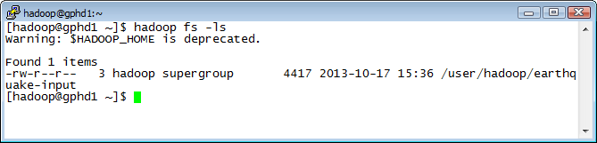
Verify Access to Hadoop Content
Usage: Verify your Hadoop user can access and read file contents
[hadoop@gphd1 ~]$ hadooop fs -ls
A fly and a flea in a flue
Were imprisoned, so what could they do
Said the fly, let us flee. Let us fly said the flee
So they flew through a flaw in the flue.
A canner exceedingly canny
One morning remarked to his granny
A canner can can anything that he can
But a canner can’t can a can can he?
Note: Verify you have access to the file being used to populate the Greenplum external table.
Notes:
Verify Access to Hadoop Content
Before attempting to create an external table and read or write to the HDFS system, you should verify that your Hadoop user can access and read content from HDFS.
In this example, the hadoop fs -ls command is used to list the user-related content for the Hadoop user, hadoop.

Slide 9
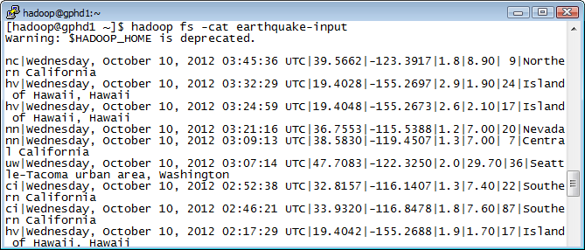
Read the HDFS Data
Usage: Granting Privileges to user gpadmin
[hadoop@gphd1 ~]$ hadooop fs –cat /user/hadoop/earthquake-input
A fly and a flea in a flue
Were imprisoned, so what could they do
Said the fly, let us flee. Let us fly said the flee
So they flew through a flaw in the flue.
A canner exceedingly canny
One morning remarked to his granny
A canner can can anything that he can
But a canner can’t can a can can he?
Note: Verify you can read the data that will be used to populate the Greenplum external table.
Notes:
Read the HDFS Data
Read the HDFS data using the hadoop fs -cat command. By viewing the content of your data, you can verify how many and what type of columns you will use when creating the external table.

Slide 10


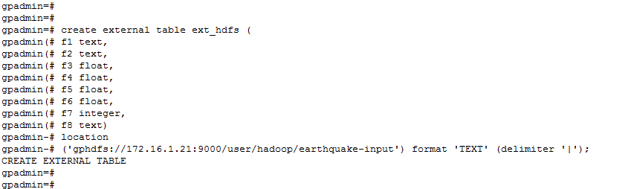
Creating an External Table
Usage: Example of an external table creation
gpadmin=# CREATE EXTERNAL TABLE TABLE_NAME (FIELD NAMES)
LOCATION (‘gphdfs://hdfs_host:port/path/file_name’)
FORMAT ‘TEXT’ (DELIMITER ‘|’);
Port number
Hadoop IP Host
A fly and a flea in a flue
Were imprisoned, so what could they do
Said the fly, let us flee. Let us fly said the flee
So they flew through a flaw in the flue.
A canner exceedingly canny
One morning remarked to his granny
A canner can can anything that he can
But a canner can’t can a can can he?
Note: Know the field types you are going to create on your external table. A field omitted or wrongly defined can compromise your data retrieval.
Notes:
Creating an External Table
The gphdfs protocol allows for a link between Greenplum and HDFS. Thus, a Greenplum external table can be populated using getting HDFS unstructured data. The data is read in parallel from HDFS into the Greenplum segments for a fast process.
Connect to your Greenplum Database environment to create an external table as shown.

Slide 11
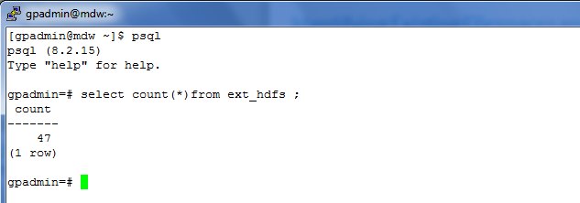
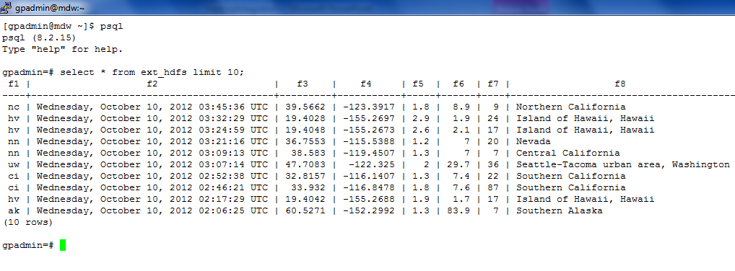
Accessing HDFS Data Loaded into Greenplum
Once the HDFS data has been loaded into Greenplum, you can use it as regular Greenplum data
Notes:
Accessing HDFS Data Loaded into Greenplum
Once the data has been loaded into the Greenplum external table you can use it as regular Greenplum data.

